Slide 1
0x103 – What is Computer Security?
ECED4406 – Computer Security
Dr. Colin O’Flynn
Dalhousie University.

Slide 2
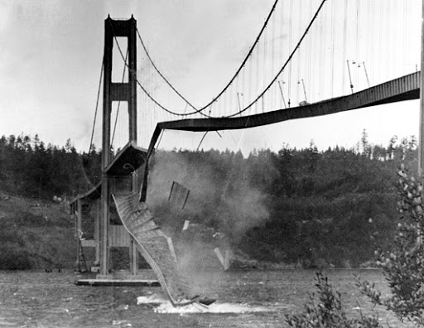
Let’s Look at Failures

Slide 3
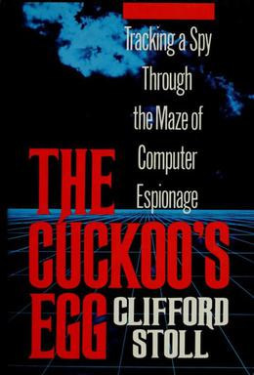
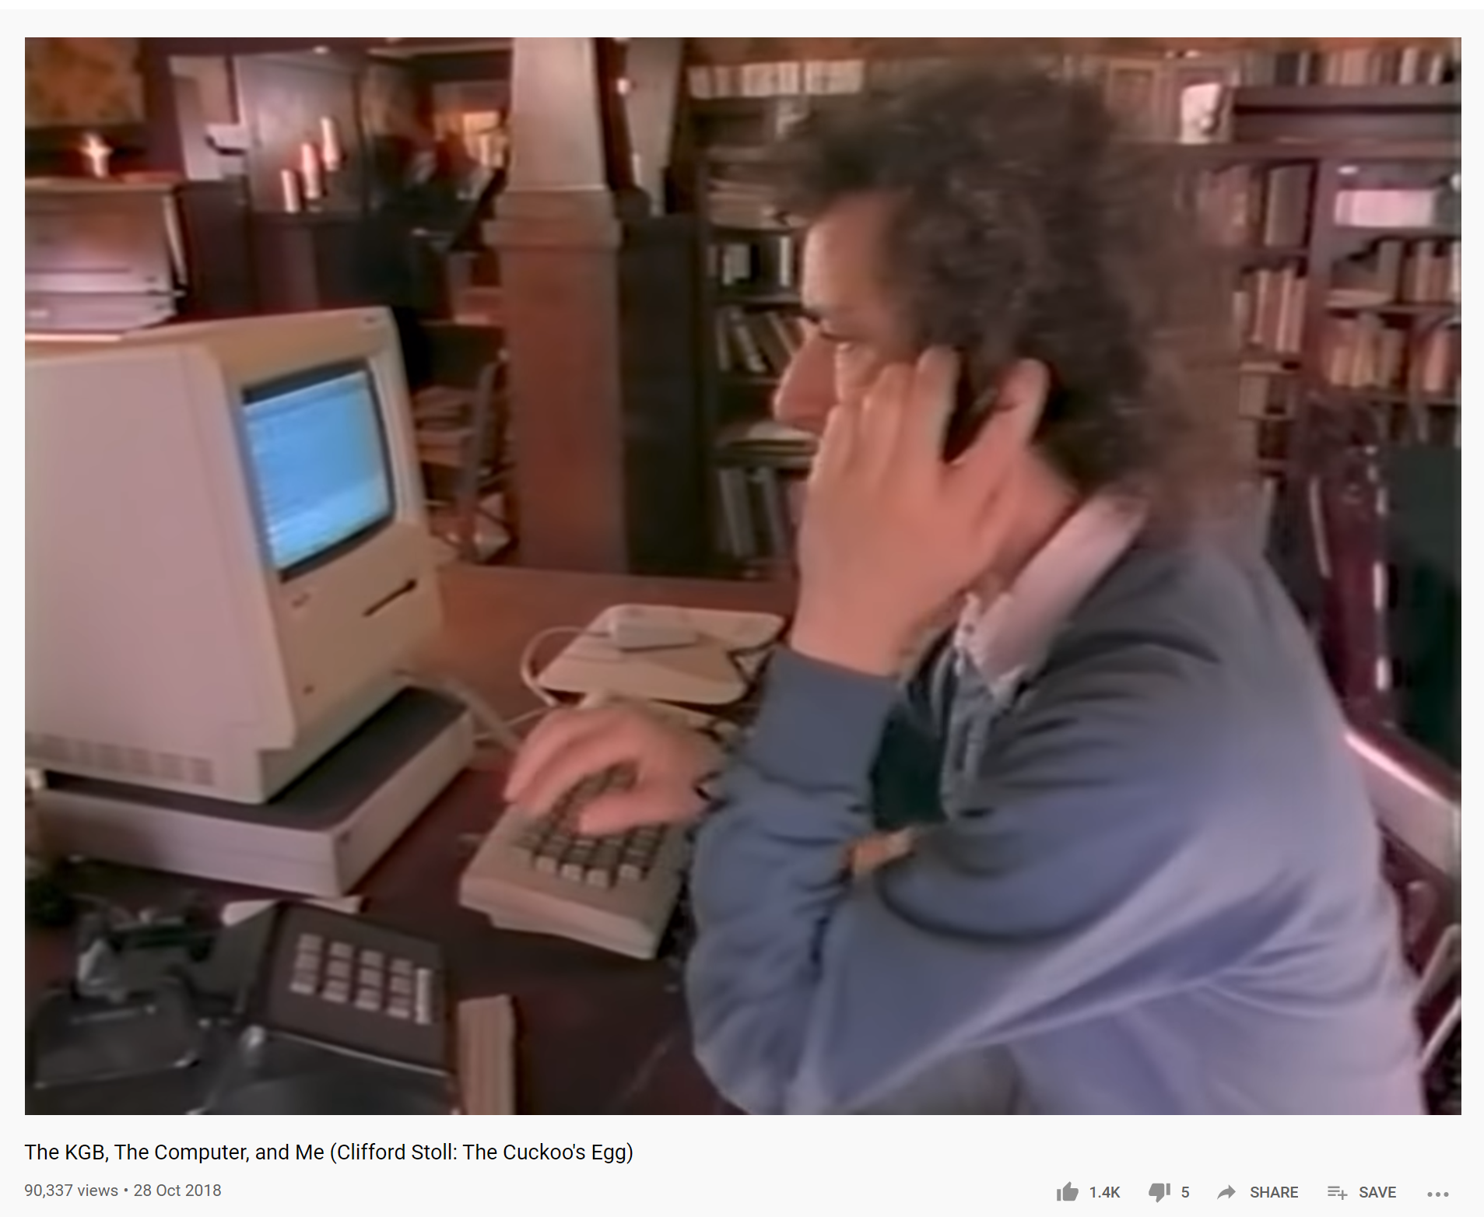
#1 Early Hackers (Late 1980’s)
The year… is 1986. Clifford Stole discovers a $0.75 error in the computer accounts…
https://www.youtube.com/watch?v=hTx9h3Sm29I

Slide 4
#1 What did this result in?
Long project to catch the hackers (also – convince FBI this is an issue!).
Hacker used fact that many people had default or not passwords (this will come up again, forever).
A ‘honeypot’ was setup with some files the hacker would be interested in, resulted in additional information about the hacker.
Hacker was stealing information to sell to KGB.

Slide 5
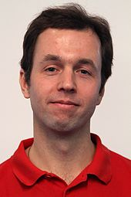
#2 United States v. Elcom Ltd. (2001)
Wrote “Advanced E-Book Processor”
Capable of removing some security mechanisms from books.
From previous slides – the “Rotate by 13” Cipher.
Arrested in U.S. under law known as DMCA (we’ll come back to this).
Charges eventually dropped.

Slide 6

#3 Target Data Breach (2013)
Hackers found (public) information on Target suppliers, such as HVAC (heating/cooling) contractor.
Hackers attacked these vendors, on assumption they will have poor security controls.

Slide 7
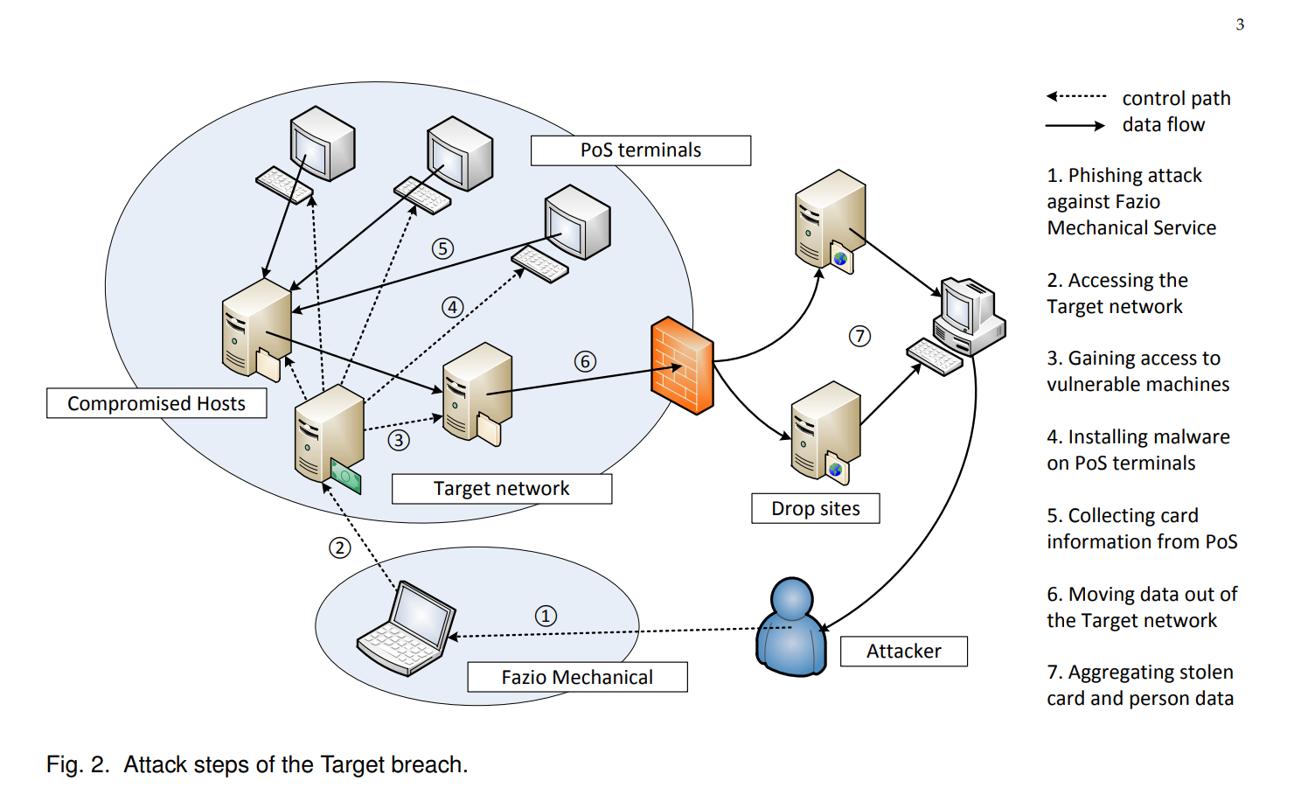
#3
Xiaokui Shu, Ke Tian, Andrew Ciambrone and Danfeng (Daphne) Yao.
“Breaking the Target: An Analysis of Target Data Breach and Lessons Learned”. https://arxiv.org/pdf/1701.04940.pdf

Slide 8
#3 What did this result in?
Objective was stealing customer information (including credit card) for fraud.
Total of 40 million customers affected.
Target claims total cost of break ~$200 million dollars.
Fined $18.5 million to settle claims in 2017.
Some charged or suspected of helping (linked):
Ruslan Bondars, 14 years
Taylor Huddleston
Andrey Hodirevski
Some starting points for more info on the topic, see:
https://malicious.life/episode/episode-29/
https://www.zdnet.com/article/anatomy-of-the-target-data-breach-missed-opportunities-and-lessons-learned/
https://www.washingtonpost.com/local/public-safety/hacker-linked-to-target-data-breach-gets-14-years-in-prison/2018/09/21/839fd6b0-bd17-11e8-b7d2-0773aa1e33da_story.html

Slide 9
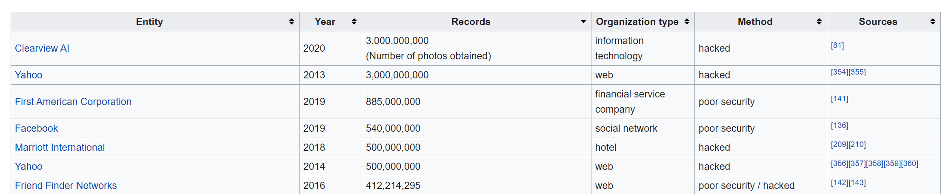
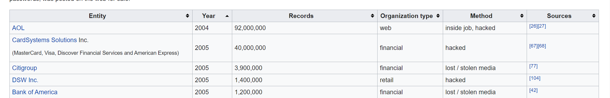
#4 – Many Other Data Breaches
Target was not first or biggest! Using https://en.wikipedia.org/wiki/List_of_data_breaches (at least 30K records leaked):

Slide 10
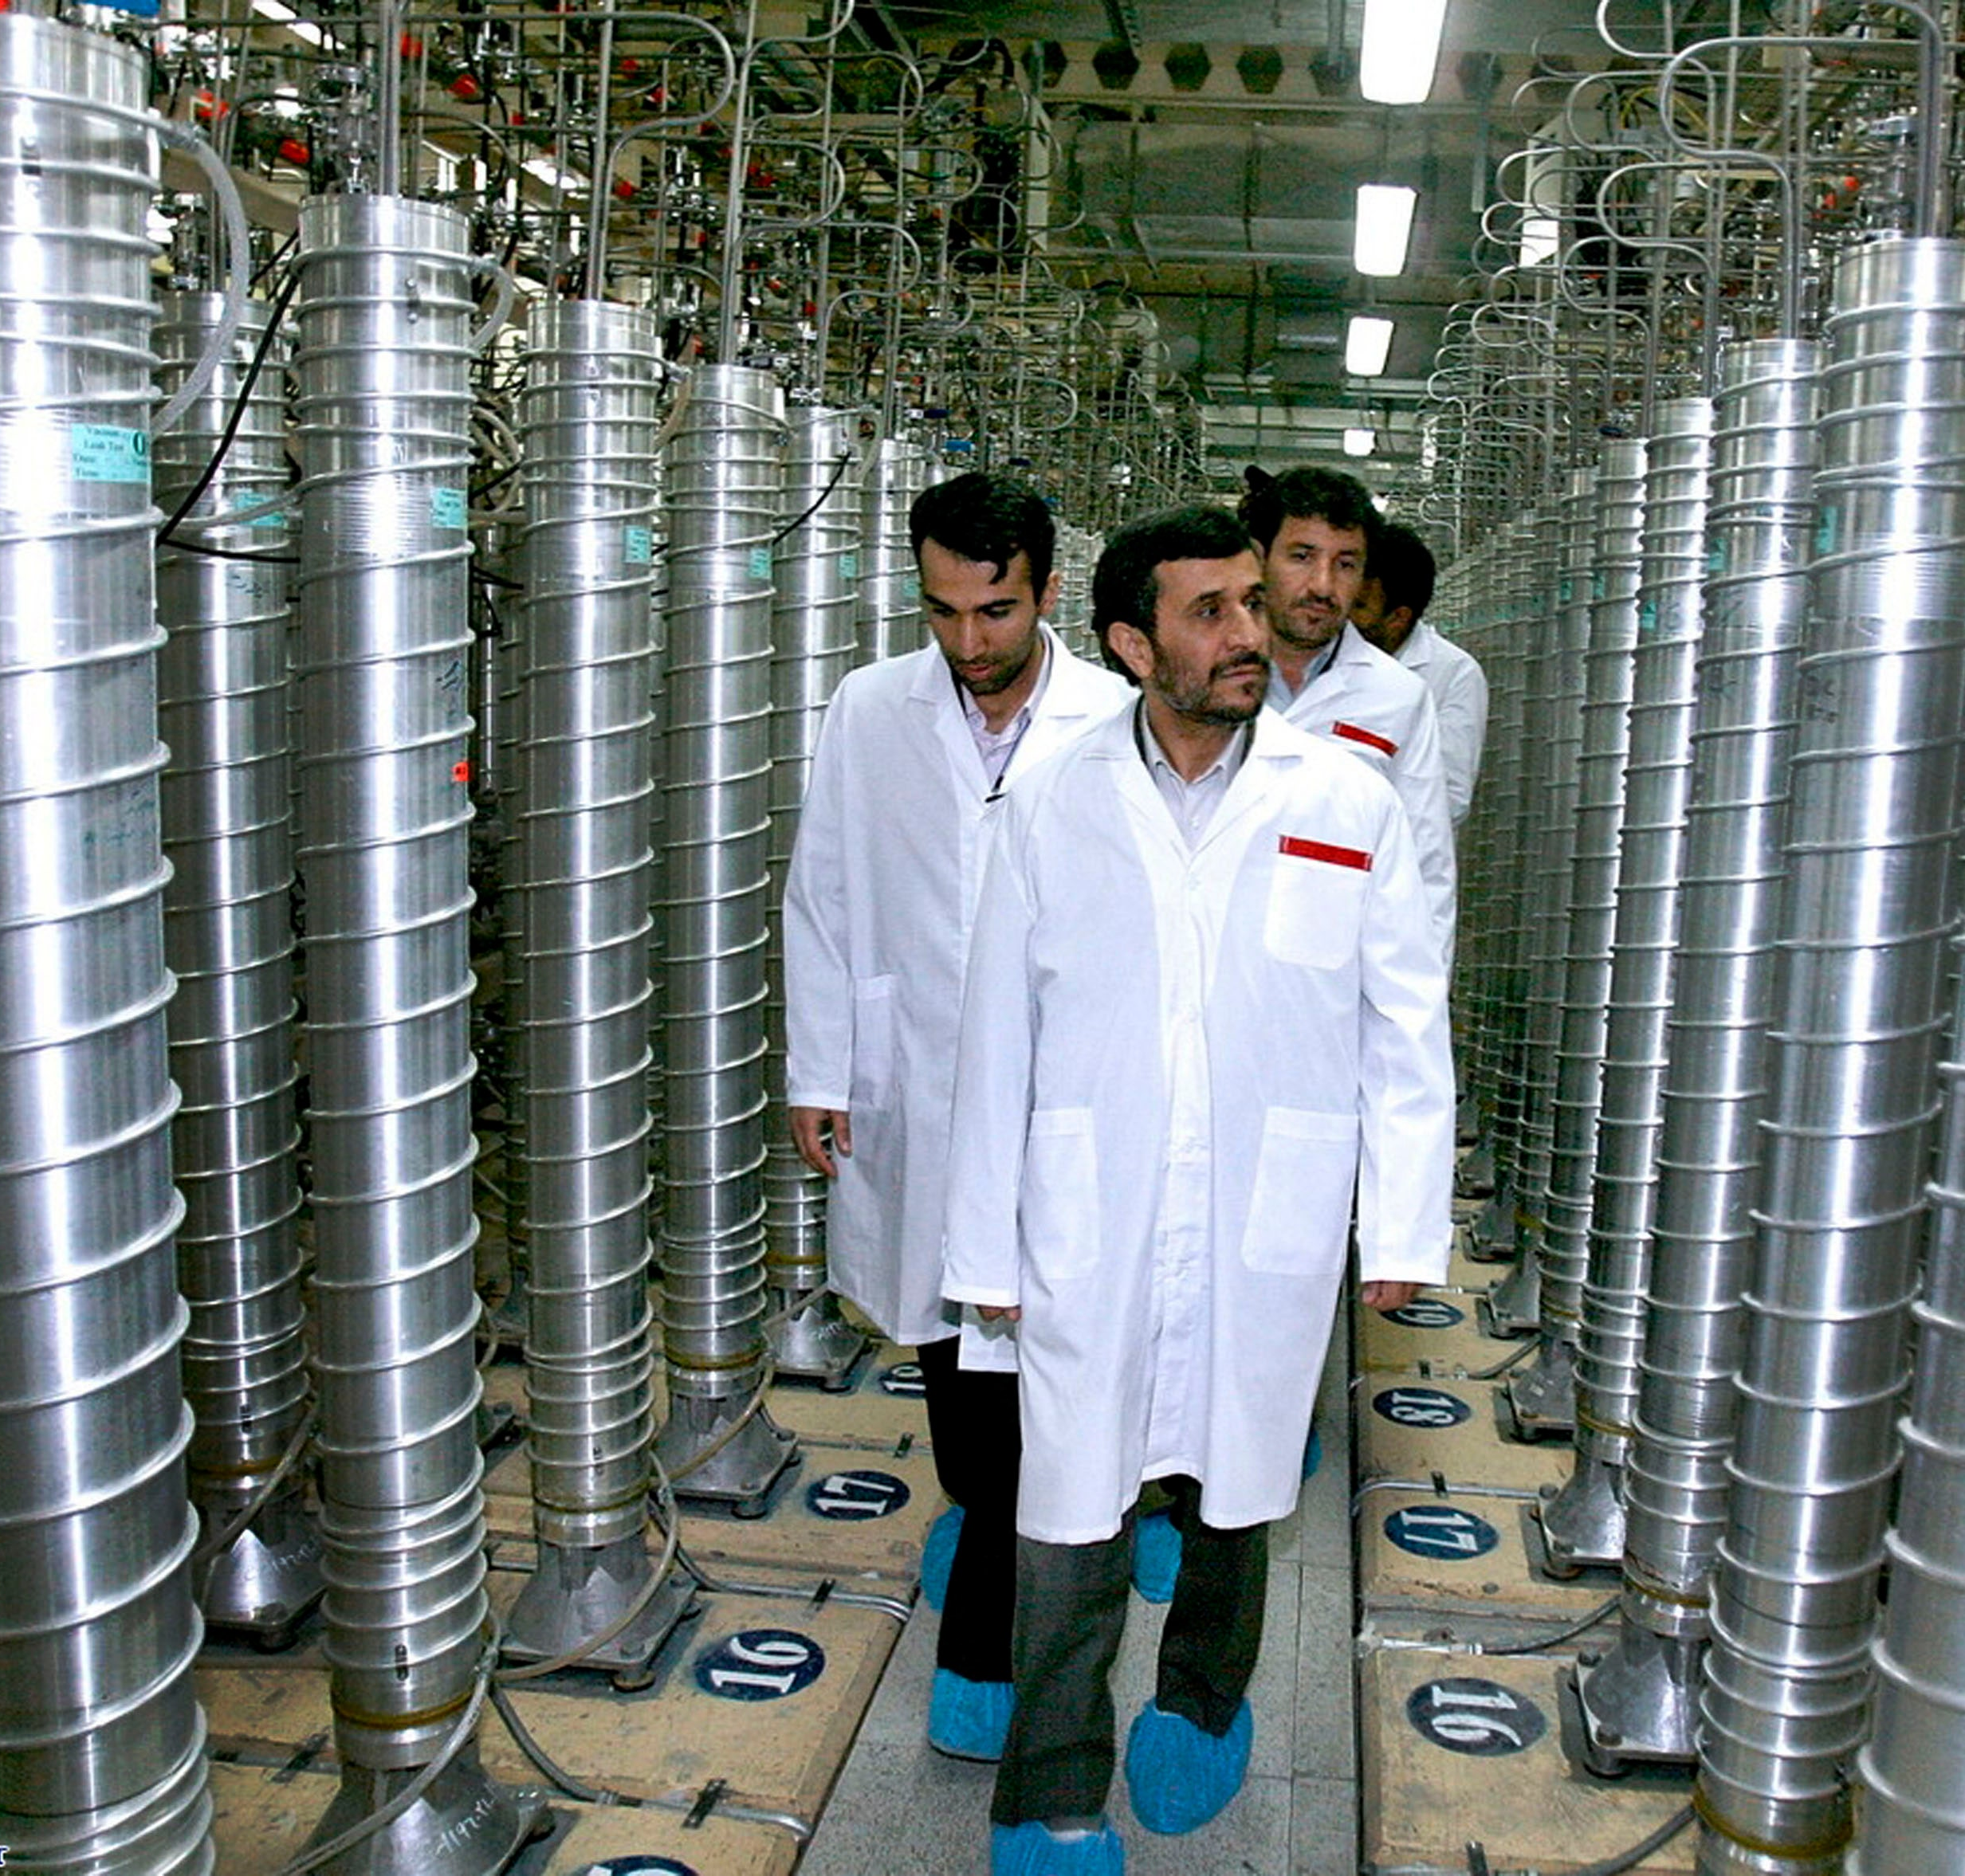
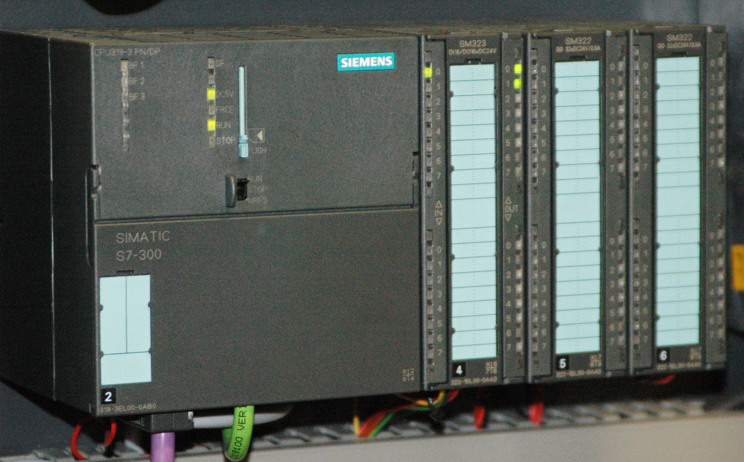
#5 Stuxnet (2010)
One of the largest (at the time) nationally-sponsored cyber-physical attack.
Objective: set back Iranian atomic program.

Slide 11
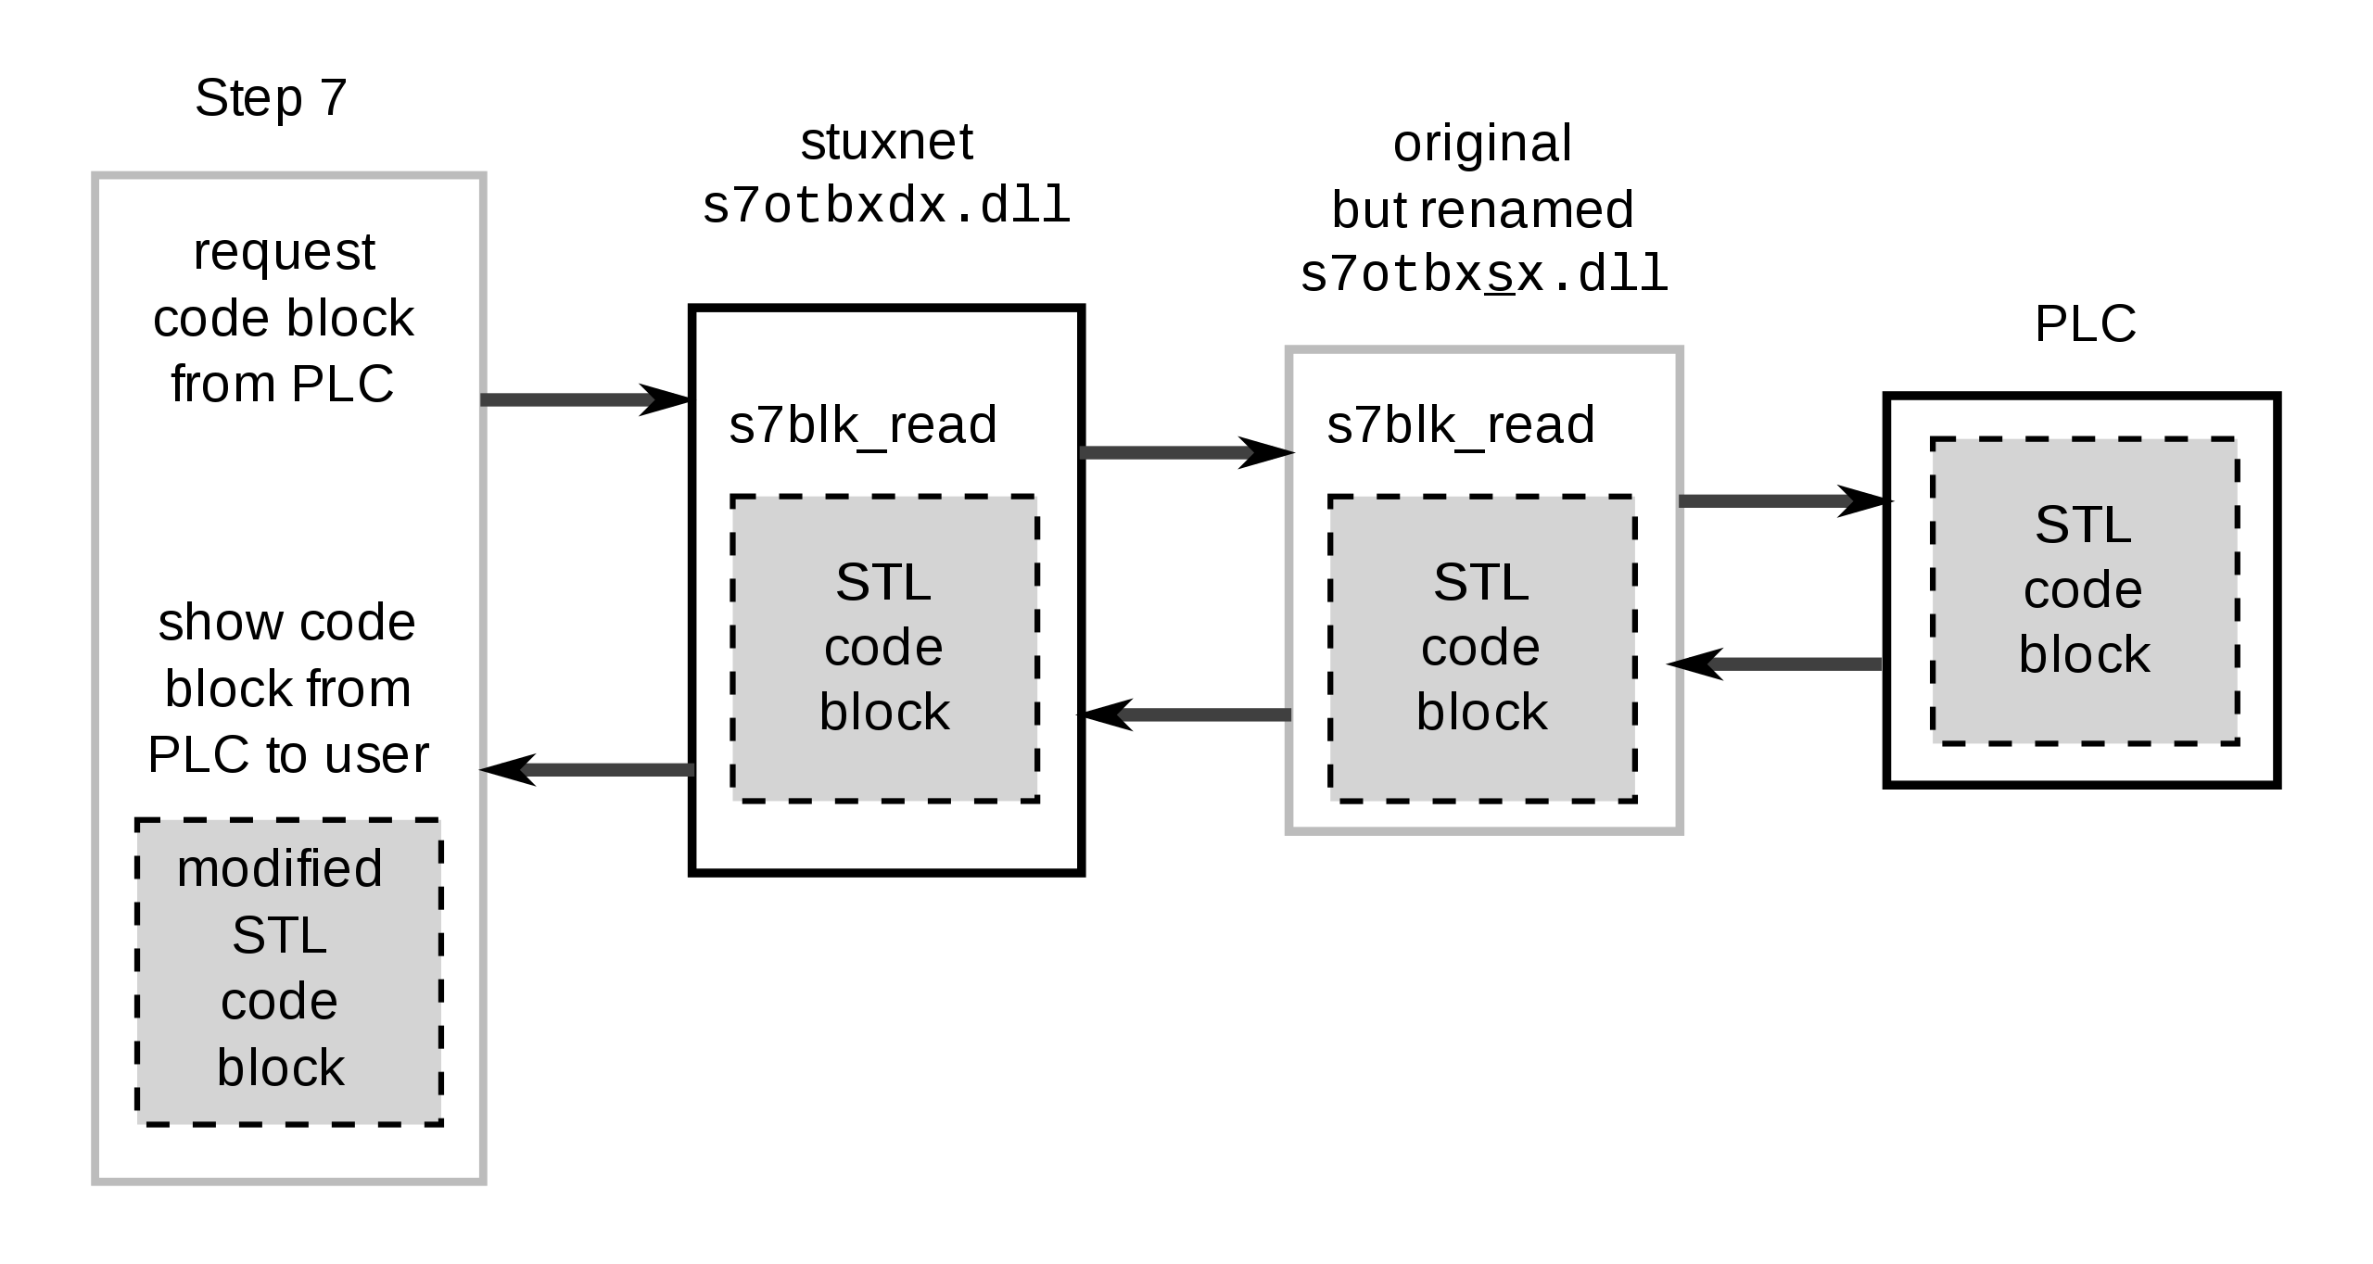
#5 – How it Worked
Computer work with very specific programming & objective:
Searched for an exact configuration of computer and PLC, as used in centrifuge control.
Malware attacked the PLC & control computer to run a complicated program.
Malware would occasionally over-speed the centrifuge, but report back to the users that everything was normal.
Malware would then return to normal operation.
For (a LOT!) more, see:
https://www.wired.com/2011/07/how-digital-detectives-deciphered-stuxnet/
https://www.amazon.ca/Countdown-Zero-Day-Stuxnet-Digital-ebook/dp/B00KEPLC08
https://en.wikipedia.org/wiki/Stuxnet

Slide 12
Important Computer Security Terms
Zero-Day
These are previously unknown “exploits”. A vulnerability in some software that has not been seen before, thus there is no protection against it.
Normally a vendor is aware of the vulnerability, and has some time to patch it. Exploits happen because of a failure of users to patch.

Slide 13
Computer Security Failures
What is objective of attacker?
Fame?
Money?
Fraud?
Military?
Revenge?
What are resources available to attacker?
Technical resources?
Funding?
Network of others to work with?

Slide 14
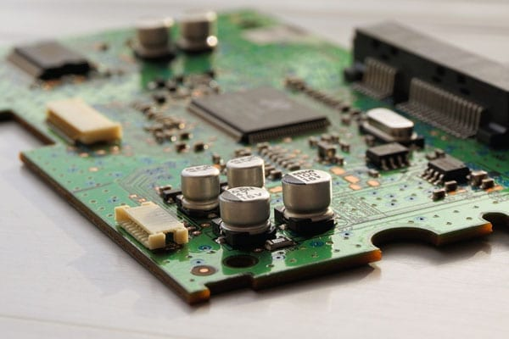
Computer Security – Relevance to Us
We are interested in embedded systems – what does that mean?

